Slide 1
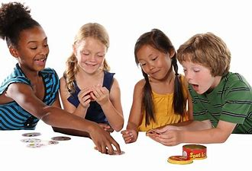
Summer Social Skills Group A unique opportunity for children to enjoy summertime fun while learning valuable social skills!​
2022 Summer Program | Ages 7 to 10
DATE: July 11th – August 5th, 2022 | 4 consecutive weeks
TIME: Monday–Friday | 10am–12pm
LOCATION: 6100 Daylong Lane, Suite 103, Clarksville, MD 21029
In-network with many insurance providers (Medicaid, Carefirst, and more!)
Learners must commit to most days to gain the most benefit.
Led by experienced Board Certified Behavior Analysts and technicians.
Space is limited so apply today to speak with our team and secure your child’s spot for summer 2022! Enrollment deadline is May 16th.
Email contact@brighterhopewellness.com | Link TBD

Slide 2
Summer Social Skills Group - FAQ A unique opportunity for children to enjoy summertime fun while learning valuable social skills!​
This group is great for kids who could use help with making and keeping friends, sharing toys and play ideas, taking turns, engaging in mutually enjoyable conversations, and much more!​
A variety of fun themes and activities are used to foster a variety of peer interactions.
The program is based on behavioral principles and teaching strategies.
Programs are designed to encourage individual growth across a variety of skills.
Groups will have a small student to staff ratio to allow for more intensive support.
Our summer program uses a variety of fun themes and activities to foster a variety of peer interactions.
Programs are designed to encourage individual growth across a variety of skills, such as initiating and sustaining conversations, managing emotions, cooperative play, and much more!
The program includes a multi-strategy approach to facilitate learning – direct instruction, role play, naturalistic teaching structured activities, supported free play, etc.
The program includes weekly progress notes supported by behavioral data.

